Slide 1

MINI PROJECT
DATA SCIENCE: BATCH-1
AANJANEY UPADHYAY(22J41A67D0)
K.GNANA TEJA(22J41A67E6)
P.VIVEK VARDHAN(22J41A67H5)
KARTHIK VANGARI(22J41A67K0)

Slide 2
Ads & Need for Classification
Social media ads appear across platforms like Facebook, Instagram, and Twitter.
These ads are personalized based on user behavior and demographics.
With growing volume and variety, manual classification is no longer feasible.
Automated systems help maintain relevance and improve ad targeting efficiency

Slide 3
Objective
to design an intelligent and scalable system that can automatically classify social media advertisements based on their content. By leveraging a combination of machine learning and natural language processing techniques, the system aims to handle large-scale ad datasets efficiently and accurately.
Automated ad classification using machine learning.
Achieve high accuracy and efficiency on multimodal data.
Provide a user-friendly interaction through a web interface.

Slide 4
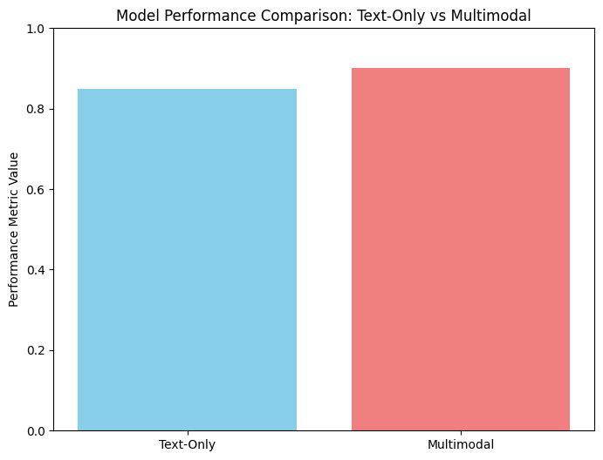
Existing Systems
Shallow ML techniques often yield low recall in noisy real-world scenarios
Visual features are underutilized, reducing overall classification accuracy
Rigid category schemas fail to capture emerging ad types like short-form videos
Image placeholder – insert comparison chart that shows text-only vs multimodal model performance

Slide 5
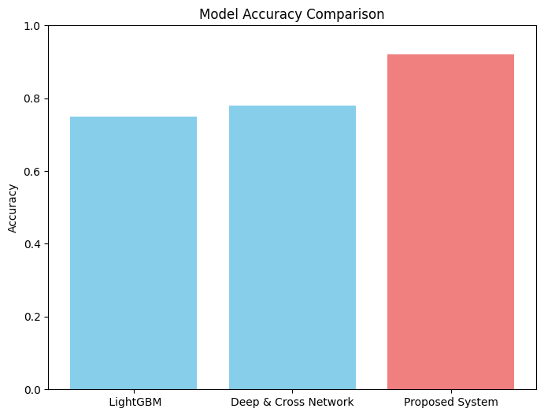
Limitations of Existing Methods
Many current systems rely on traditional algorithms like decision trees or SVMs, which underperform on real-world data.
Manual taxonomies are often outdated or too rigid for dynamic creative content.
Ad data is complex with slang, emojis, and abbreviations, making NLP classification error-prone

Slide 6
Proposed System
Our system uses a streamlined pipeline that begins with collecting data from Facebook, Instagram, and Twitter. Text is cleaned and tokenized, while images are resized and normalized. Features are extracted using text embeddings and convolutional neural networks, incorporating transfer learning models such as VGG19 or NASNet. These features are then combined and passed through either an ensemble classifier or a deep learning model. The output is a categorized ad with a confidence score. The approach is automated, scalable, multimodal, and modular, allowing for efficient updates and future improvements.

Slide 7
Literature Survey
Social media ad classification has been explored through various approaches including keyword-based filtering, statistical models, and early deep learning applications. Traditional keyword-and-rule systems are easy to implement but often miss nuanced content. Machine learning methods such as SVMs and random forests improved performance, though they struggle with visual components. Recently, multimodal deep learning models that combine text embeddings and image features have demonstrated superior accuracy and generalization on large, diverse datasets.

Slide 8
Methodology of the Proposed System
Our system builds upon existing methods by combining advanced text and image processing techniques in a unified framework. Text inputs are processed using transformer-based embeddings, while visual features are extracted using pretrained convolutional neural networks like VGG19 . The resulting feature vectors are fused and passed through an ensemble classifier, which predicts the ad category along with a confidence score. This multimodal strategy enhances adaptability to evolving ad formats and increases the system’s resilience to noisy or varied content.

Slide 9
Software and Hardware Requirements
Software: Python 3.8+, PyTorch, HuggingFace Transformers, Streamlit for web interface
Hardware: GPU-enabled machine (support for Cuda, Torch,e.t.c)
Storage: Medium level(24 kb) for datasets and model artifacts

Slide 10
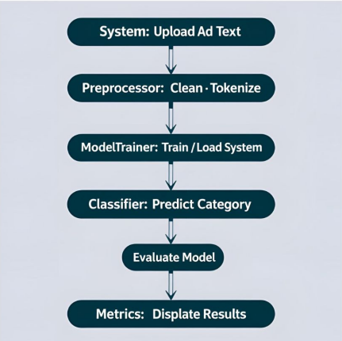
System Architecture
The system uses a modular pipeline for ad classification
Raw ad text and image are taken as input from the user
Text goes through cleaning, tokenization, and vectorization
Images are resized and normalized for model input
Feature extraction is done separately for text and images

Slide 11
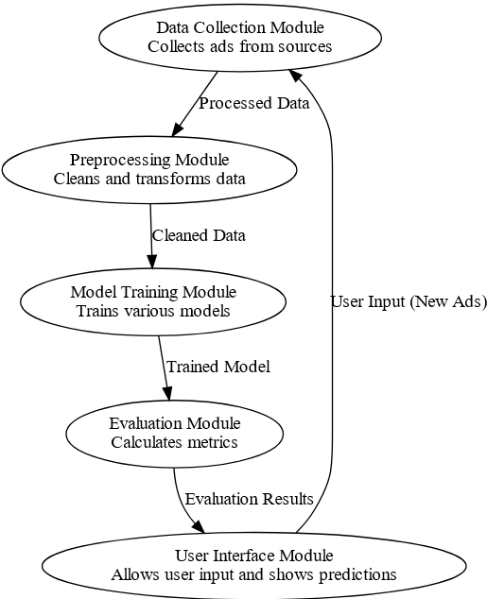
Modules Overview
Data Collection Module Collects ads from sources such as Facebook and Twitter using APIs or pre-built datasets
Preprocessing Module Cleans and transforms both text and image data into usable formats
Model Training Module Includes logic for training various models like CNN, VGG16, VGG19, and NASNet
Evaluation Module Calculates accuracy, precision, recall, and F1-score
User Interface Module Allows users to input ads and view predictions through the web

Slide 12
Purpose of NLP in the Project
NLP techniques helped convert ad text into numerical representations
Preprocessing included lowercasing, stop-word removal, and punctuation cleanup
TF-IDF is used to vectorize text for machine learning models
NLP allowed the system to detect context, intent, and category from short ad phrases
Text classification formed the foundation of most prediction outputs

Slide 13
Structure of NLP
Text Preprocessing
Modeling Approach
Converting all text to lowercase to maintain consistency
Removing stop-words (common words like "the", "and", etc.
Removing punctuation and special characters
Handling slang, abbreviations, and informal language often found in social media ads
TF-IDF vectors used with Logistic Regression and Random Forest
The vectorized features were input to classifiers to predict the category of each ad
The modeling focused on learning patterns in word usage across different ad types
Text-based predictions combined with image-based outputs

Slide 14
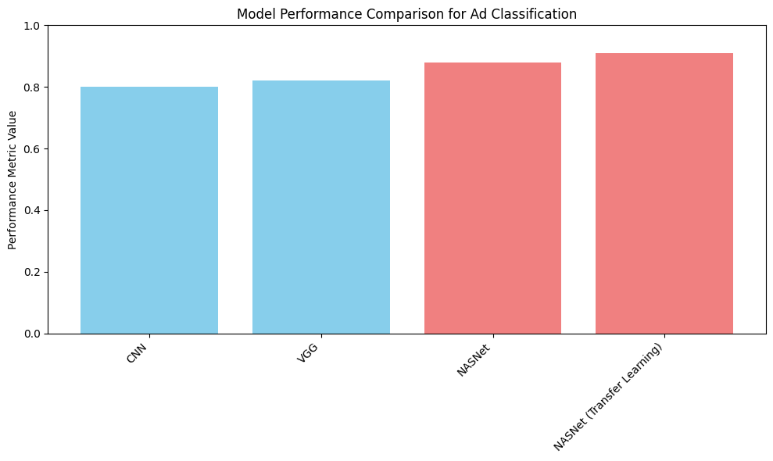
NASNet and Transfer Learning
NASNet is a neural architecture search model used for image processing
It is added to compare performance with other models like VGG and CNN
It helps identify if automatic architecture tuning performs better on ad classification
Transfer learning allows us to reuse parts of large models and fine-tune them

Slide 15
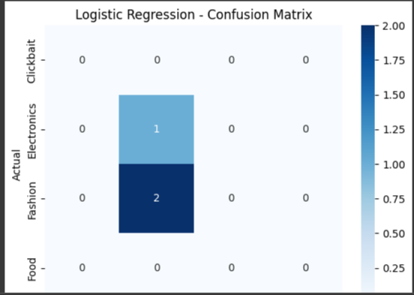
Logistic Regression – Overview
Logistic Regression was applied to TF-IDF-based ad text features
It is a simple linear classifier suitable for multi-class tasks
Performed well with clean, structured input
A confusion matrix was generated to evaluate model predictions
Results showed good classification on common categories

Slide 16
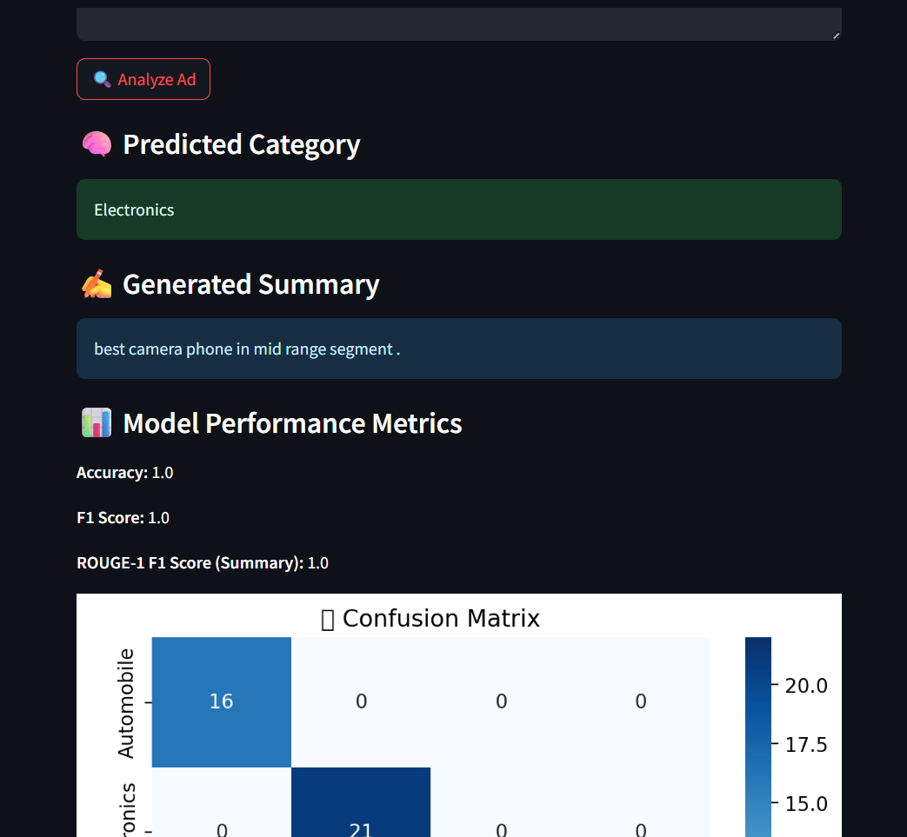
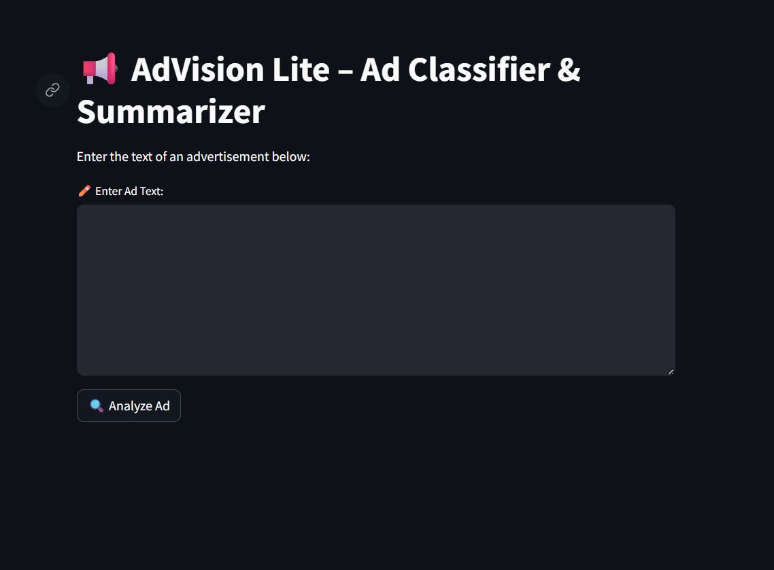
Interface

Slide 17
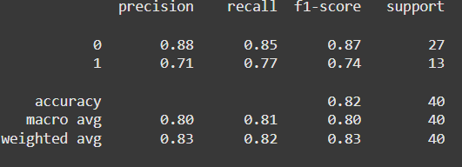
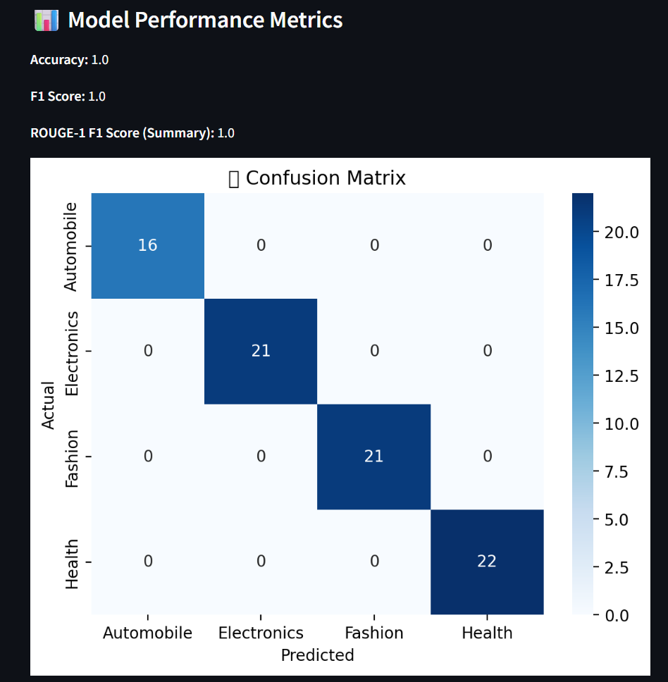
Evaluation Metrics

Slide 18
Future Scope
The system can be improved by using a larger and more diverse dataset.
Support for regional languages and informal content can be added.
Real-time classification of live social media ads is a possible extension.
User feedback can help the system learn and improve over time.
Exploring newer model architectures may boost accuracy further.
Deploying the system as an API could make it more accessible and useful.

Slide 19
Conclusion
This project focused on classifying social media ads using machine learning.
Rich text features were used for better prediction.
Logistic Regression and Random Forest handled text inputs.
Evaluation with metrics like accuracy and F1-score showed reliable results.
Combining multiple features improved overall classification performance.

Slide 20
References
https://gingermediagroup.com/blog/classification-of-advertising/
https://foiworks.com/classification-of-advertising/
https://www.taylorfrancis.com/chapters/mono/10.4324/9781315062754-31/classified-advertising-john-mcdonough-karen-egolf
https://www.statista.com/study/38849/digital-advertising-report-classifieds/

Slide 21


